Slide 1
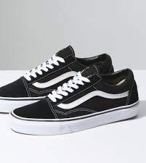
NJHS NEDS YOUR HELP!
NJHS is collecting shoes of ALL sizes to donate to Holy Redeemer’s Sister Diocese in the Dominican Republic.
Donations will be collected from Monday November 14th through Monday December 5th.
Donations will be collected in the boxes outside of your home room classrooms.
Please note that sneakers must be new and unworn.
Thank you and God Bless!

Slide 2
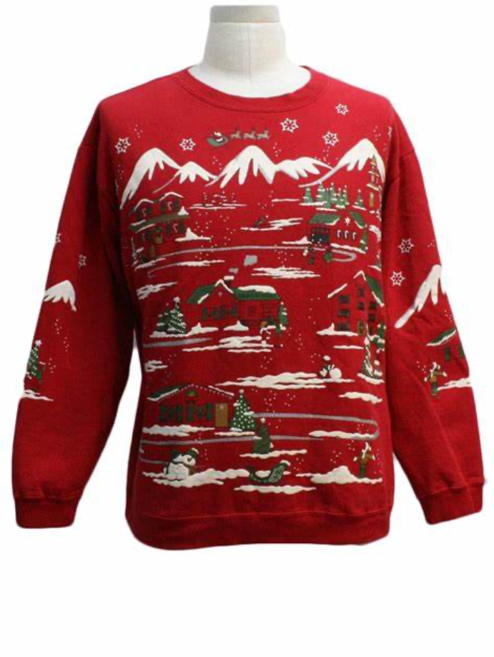
NJHS’ UGLY CHRISTMAS SWEATER CONTEST
NJHS Will be hosting an Ugly Christmas sweater contest on December 13th!
The cost to participate is $3.00 (Fee will be deducted from FACTS account)!
1 lucky winner will be selected from each homeroom class. The winner will receive a NUT day pass for 2023!
3 staff members who participate in the contest will earn 1 dozen of Mrs. Morgan’s delicious cookies!
Holy Redeemer’s NJHS community sends much thanks, as well as a safe and Merry Christmas!

Slide 3
Holy Redeemer is asking for your participation in our monthly NUT days!
This year, Holy Redeemer has decided to ask for a donation to the food pantry instead of the original $2.00 fee to participate in NUT days!
Your donation goes to Holy Redeemer Catholic Church’s food pantry, and helps multiple families every week!
Please donate a non-perishable food item to the food pantry to participate in monthly NUT days.
Thank you for your generosity and kind donations, by doing this, we hope to help the families in poverty living in Osceola County.
NUT DAYS THIS YEAR
*Please note that NUT day dates are subject to change.

